Slide 1
Electronica - A-Z electronics
Presented by:
Kamini Prem Prakash
Harsh Shahdev
Nandika Vasanthmurali
Sakshi Gupta

Slide 2
DATABASE PURPOSE
Maintain a data of all the available products.
Maintain the purchasing records of customers.
Browse user’s information and order history by Administrators.
Gather valuable insights in terms of items sold, revenue made.

Slide 3
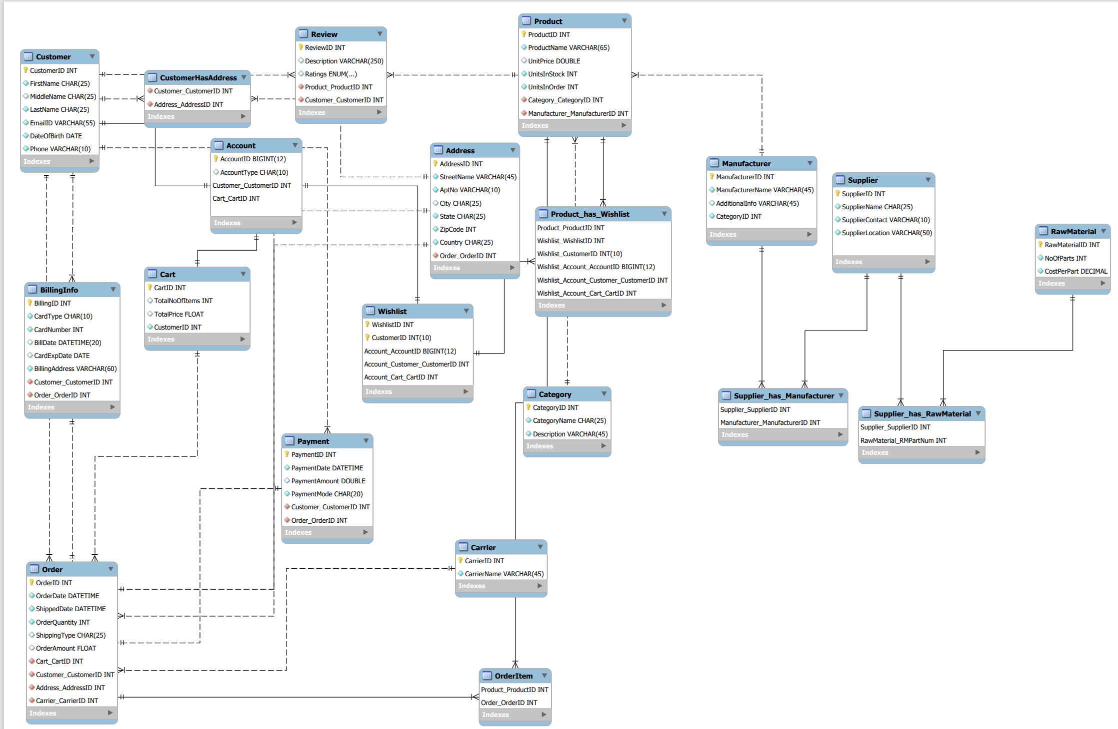

Slide 4
DESIGN DECISIONS
Major entities are Customer, Product, Order, BillingInfo, Manufacturer, Supplier, Payment.
Associative entities are Customer_has_Address, Product_has_wishlist, supplier_has_manufacturer, supplier_has_rawmaterial, order_item.
Customer can add reviews and ratings to the product they purchase.

Slide 5
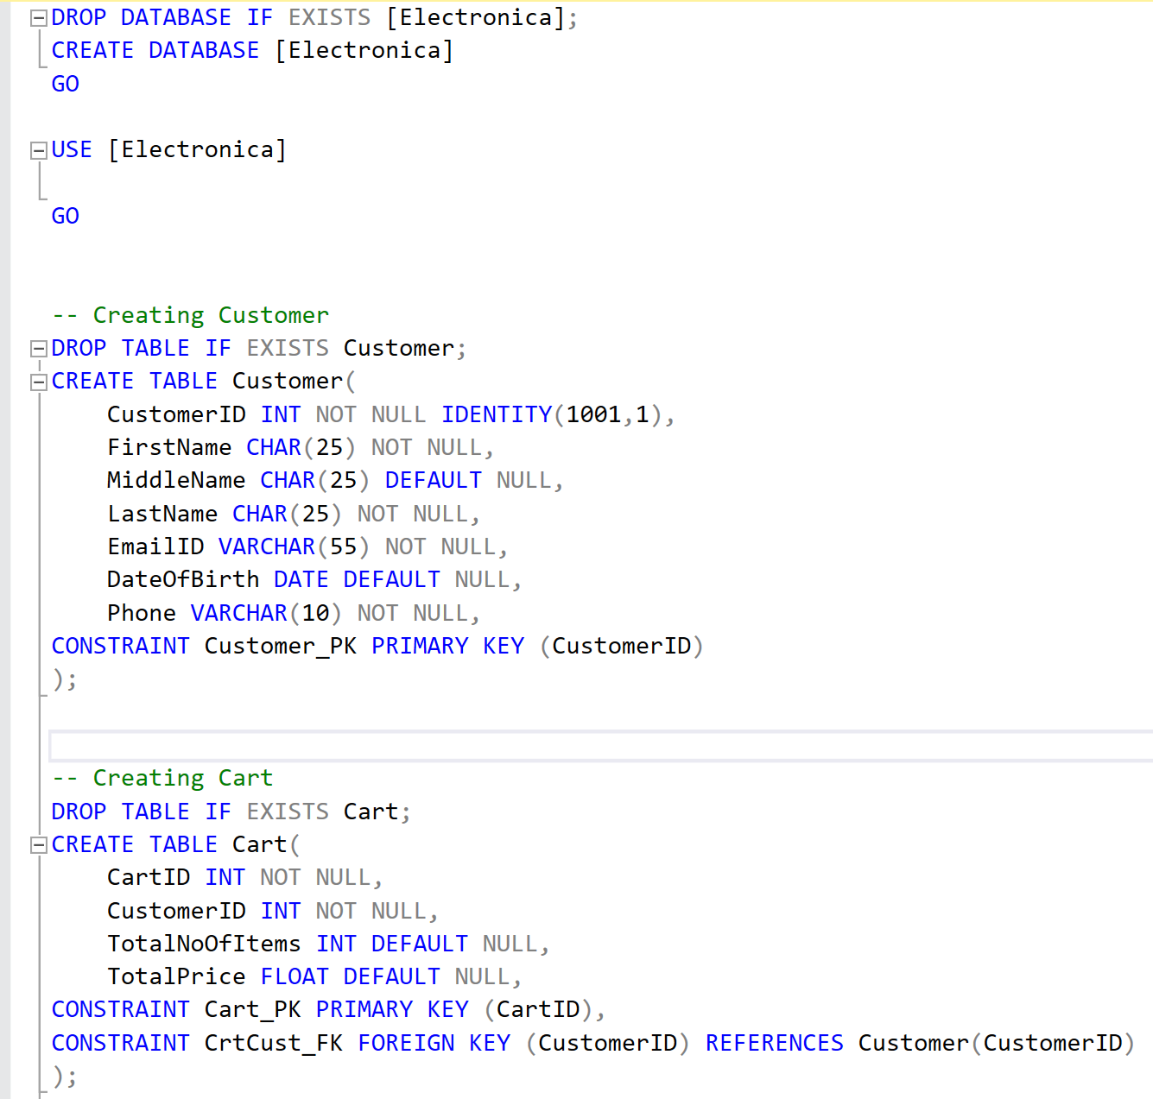
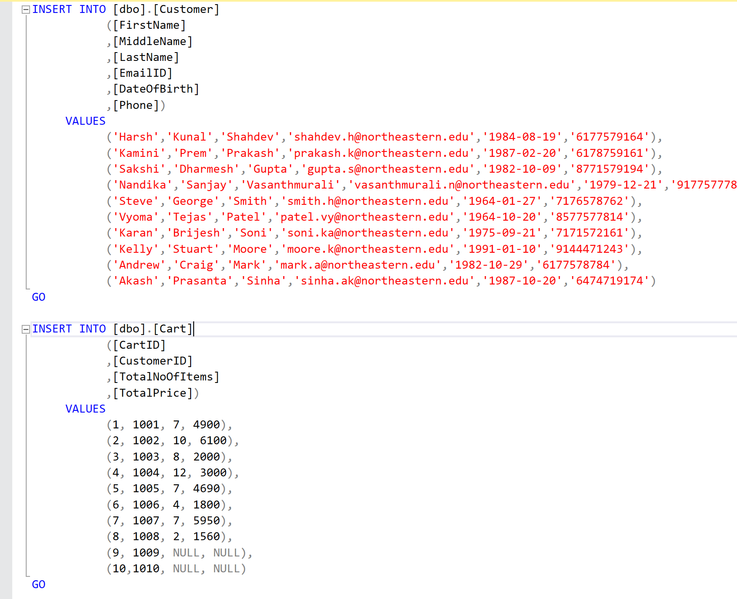
DDL STATEMENTS TO IMPLEMENT THE DATABASE

Slide 6
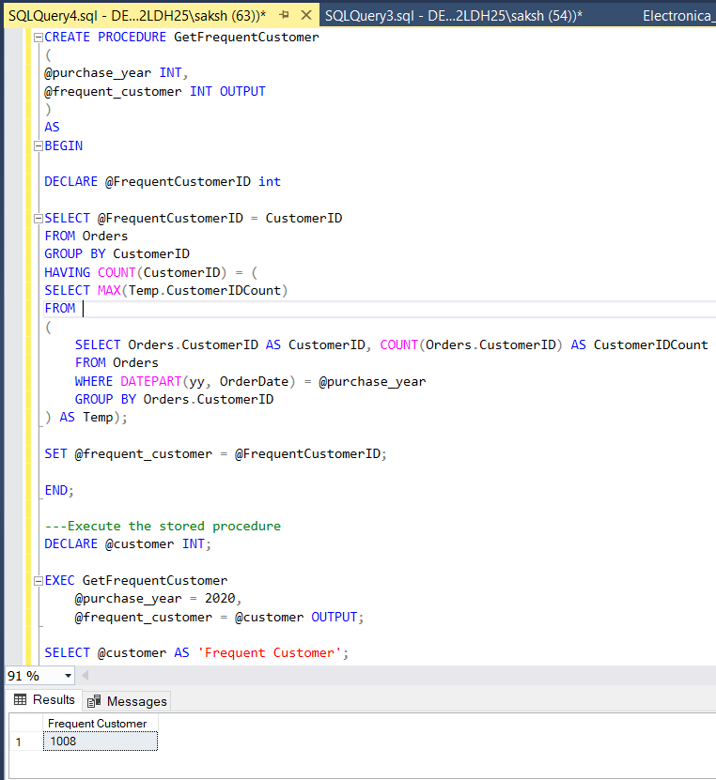
STORED PROCEDURES
To get the customer with frequent orders in a particular year.

Slide 7
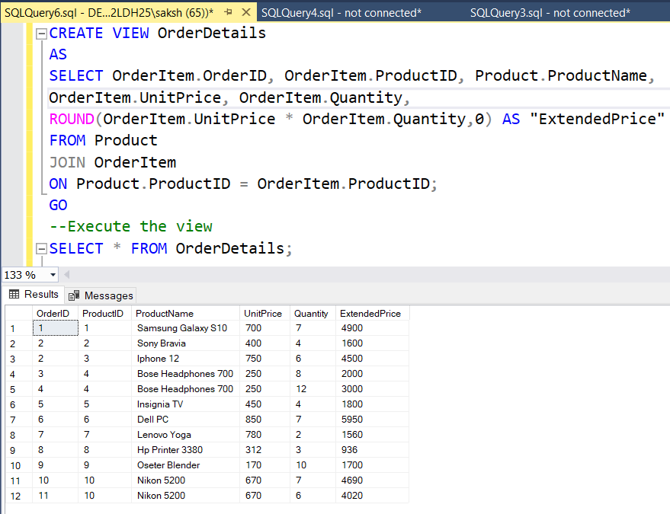
VIEWS
View to get all the details of an order

Slide 8
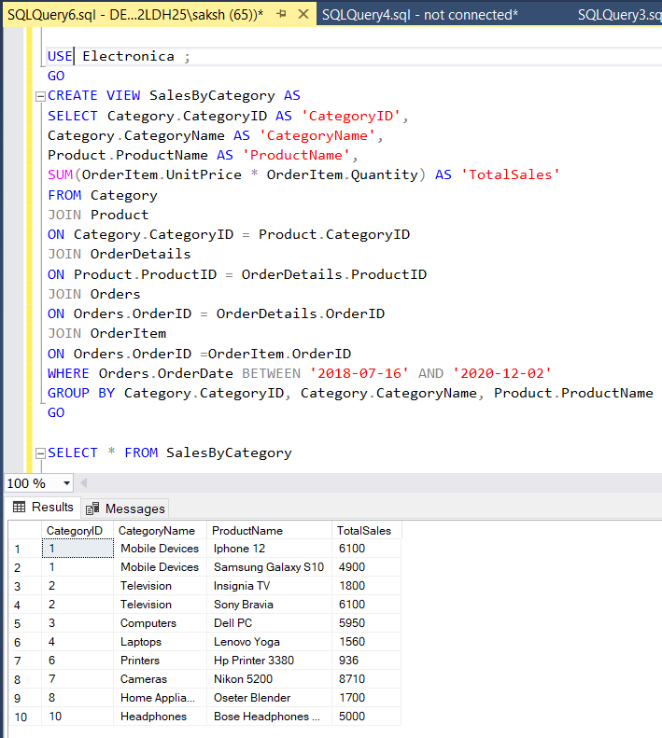
View to get sales by category of the products. This view uses another view ‘OrderDetails’

Slide 9
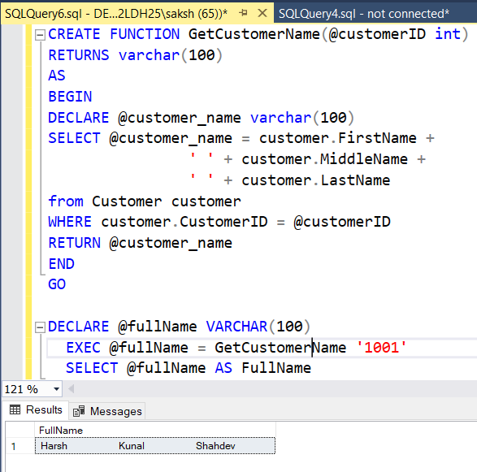
FUNCTIONS
Function to get the full customer name of a particular customer

Slide 10
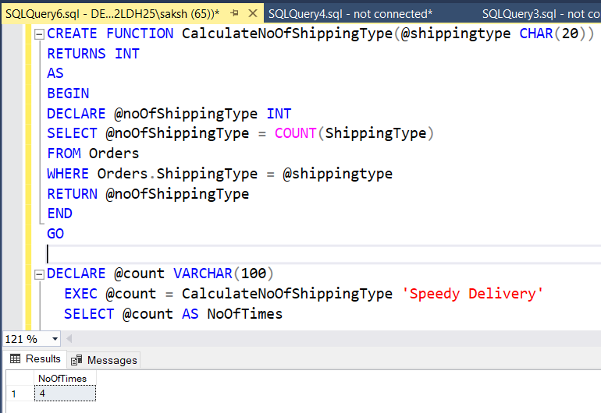
Function to calculate the count of the types of Shipping Modes used for delivery of orders

Slide 11
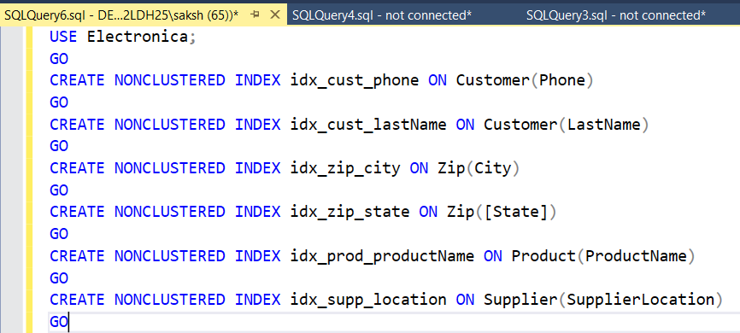
NON-CLUSTERED INDEXES
To help us retrieve data quickly from the database we have following non-clustered indexes in our database

Slide 12
REPORTS
Time in which maximum orders took place.
Total order amount for each Customer
Count of Orders delivered by ‘Standard Shipping’ and ‘Speedy Delivery’ in year 2018,2019, and 2020.
Top 3 Customer IDs that spent the most.

Slide 13
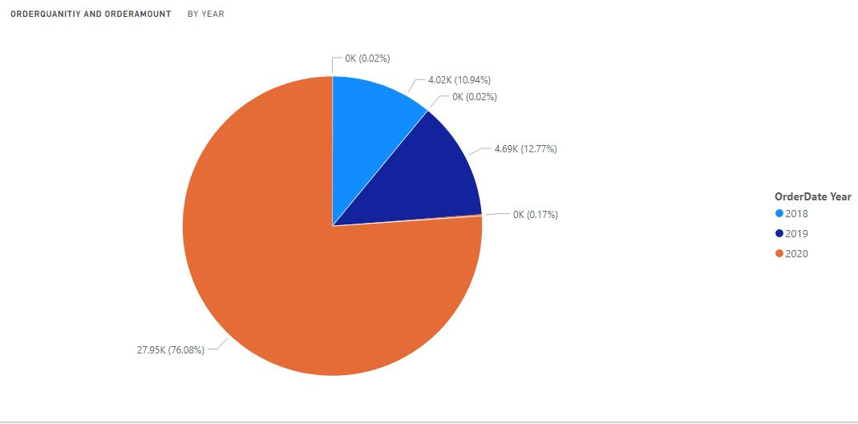
Order Quantity and Order Amount in year 2018,2019 & 2020

Slide 14
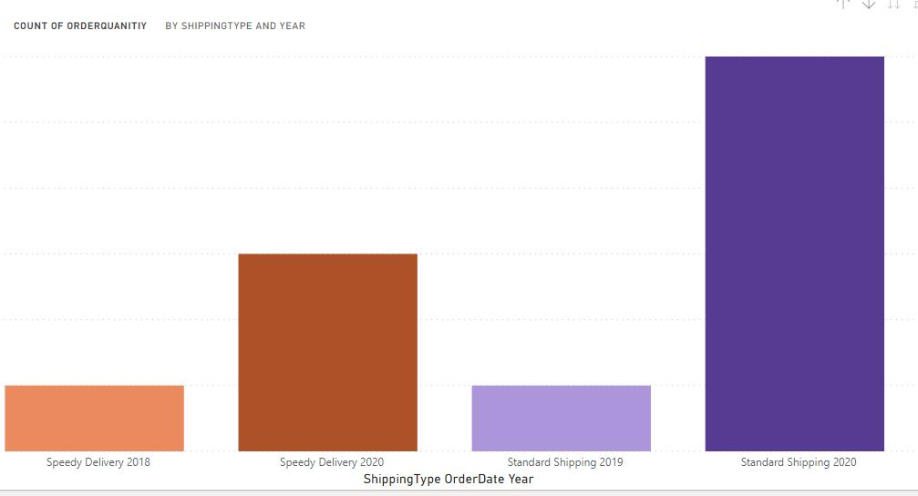
Count of Orders delivered by ‘Standard Shipping’ and ‘Speedy Delivery’ in year 2018,2019, and 2020

Slide 15
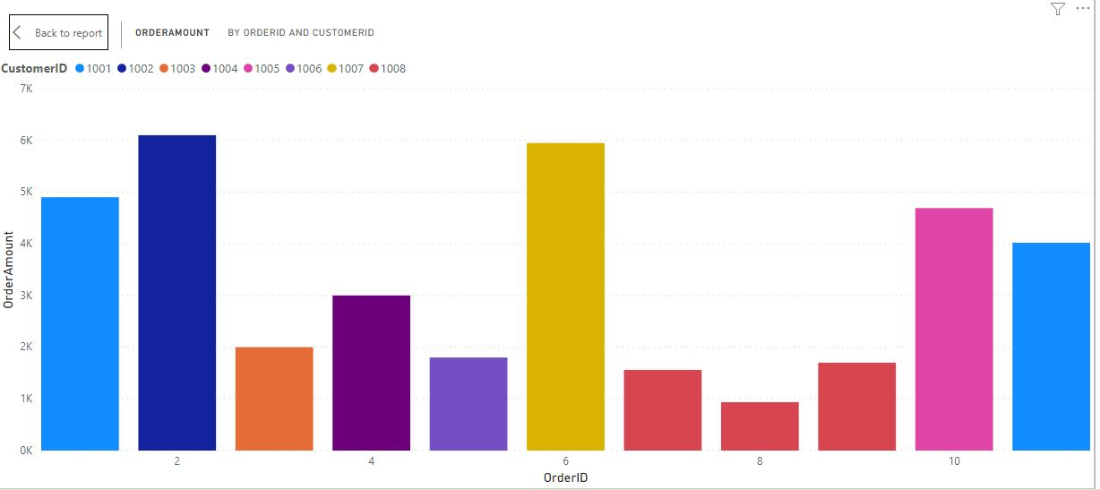
Total Order Amount for each Customer

Slide 16
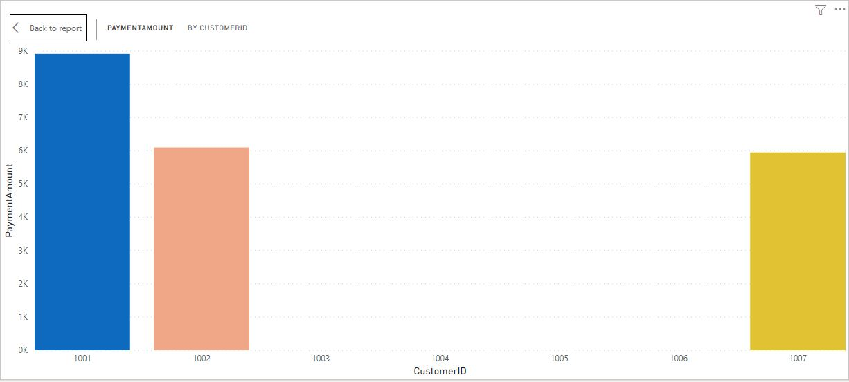
Top 3 Customer IDs that spent the most

